Slide 1
Data Mining & Machine Learning 1
Hotel Reservation Cancellation prediction and
Predictive Analytics of Airbnb
Aafaq Iqbal Khan X20108851

Slide 2
Introduction
The project is consisted of 3 parts
Hotel Booking Cancellation prediction:
Price prediction of New York Airbnb Market
Price Prediction of London Airbnb Market

Slide 3
Datasets
Hotel Booking Cancellation prediction:
Source: Kaggle
Shape: 119,390 records and 34 features
Target variable: “is cancelled”
Price prediction of New York Airbnb Market:
Source: Airbnb official website
Shape: 37k records and 74 features
Target variable: “price”
Price Prediction of London Airbnb Market:
Source: Airbnb official website
Shape: 79k records and 74 features
Target variable: “price”

Slide 4
Methodology

Slide 5
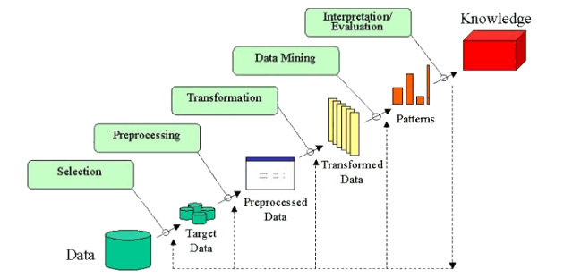
Knowledge Discovery in Databases (KDD)
The KDD methodology process is defined as follows:
Data sourcing and selection
Preprocessing and transformation: cleaning, attribute selection
Data Mining: Implementation of Algorithms
Evaluation: interpretation
Post-process: identifying interesting or useful
patterns

Slide 6
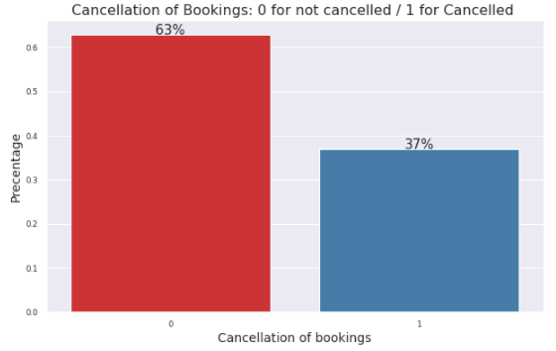
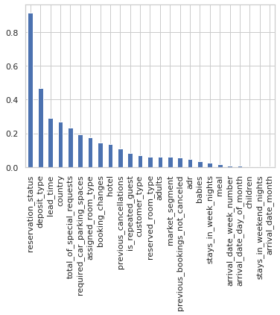
Hotel Booking Cancellation prediction
Missing Value dealing
Feature | Null sum | Percentage of Null | Imputed Value
country | 488 | 4% | PRT
children | 4 | 0.0033% | 0.0
Transformation and encoding: Label Encoder and One hot
Imbalance data
Correlation of target variable with features

Slide 7
Hotel Booking Cancellation prediction
Binary Classification
Gaussian Naive Bayes
Logistic regression
Decision tree,
Random Forest
Class Imbalance Handling
Balanced Resampling
Under Sample Imbalance Technique
Class_weight = balanced
SMOTE Imbalance Technique:
Borderline Smote Imbalance Technique

Slide 8
Hotel Booking Cancellation prediction
Evaluation
classification score (accuracy)
Precision
Recall
F1 Score
ROC score
Kappa
Confusion metric
ROC curve

Slide 9
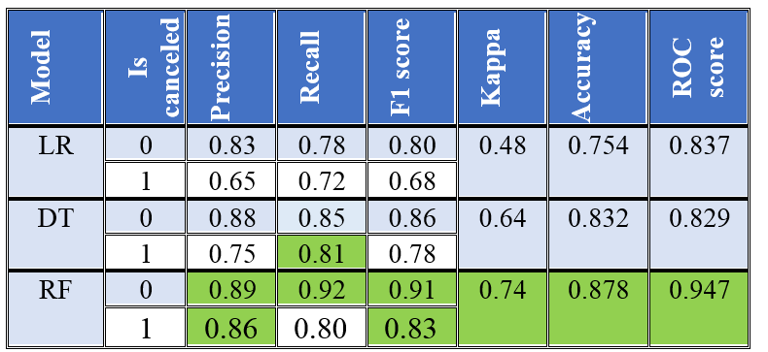
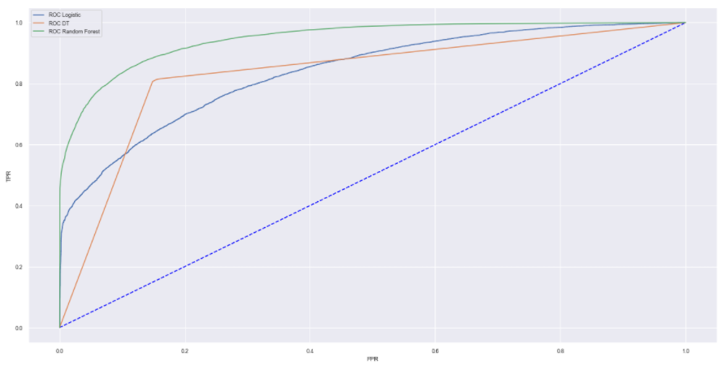
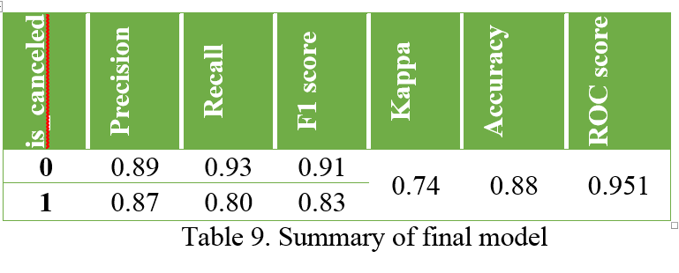
Hotel Booking Cancellation prediction
Models Results
Final Models with hyper-parameter tuning Results

Slide 10
Price prediction of New York Airbnb Market

Slide 11
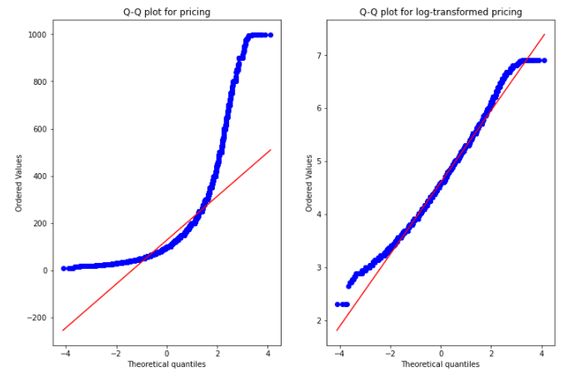
Price prediction of New York Airbnb Market
Missing Value dealing
Drop any entries that are inconsistent; i.e. predictors accommodates, bedrooms, beds, or price with a value of 0.
Transformation and encoding: Label Encoder and One hot
Normal distribution before and after log transformation

Slide 12
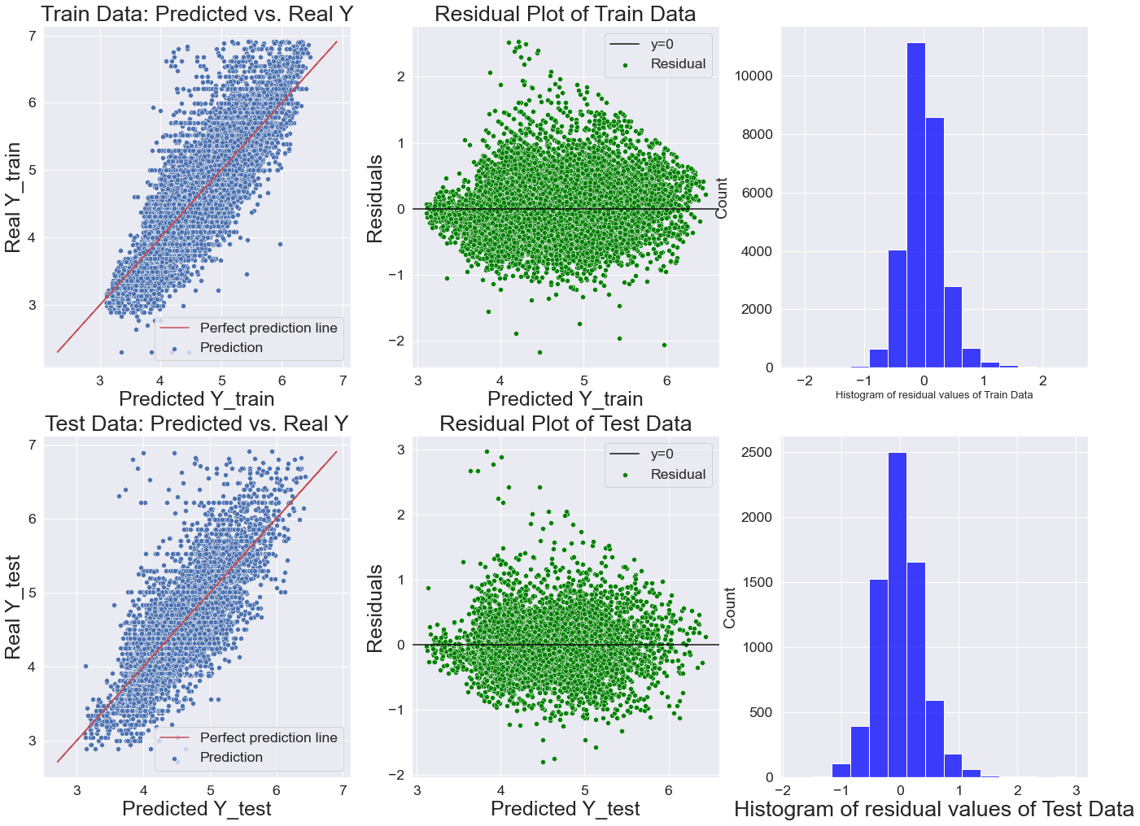
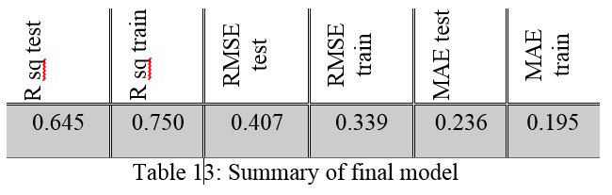
Price prediction of New York Airbnb Market
Regression
Final Model results
Random Forest regression
Decision tree regression
Linear Regression
Evaluation
R-squared
RMSE
Median Absolute Error
Residual Plots

Slide 13
Price prediction of London Airbnb Market

Slide 14
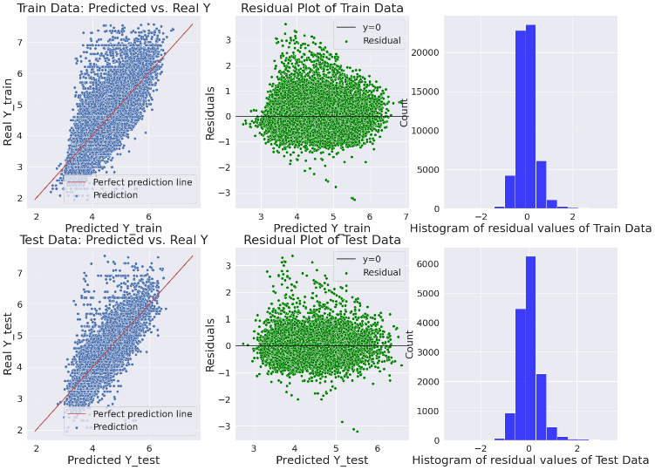
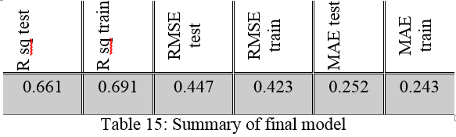
Price prediction of London Airbnb Market
Regression
Final Model results
K-nearest neighbour Regressor
Extreme Gradient Boosting (XGBoost).
Evaluation
R-squared
RMSE
Median Absolute Error
Residual Plots

Slide 15
Failure faced

Slide 16
CONCLUSION AND FUTURE WORK

Slide 17
CONCLUSION AND FUTURE WORK
Foreign customers are more cautious on canceling bookings when traveling in another country.
User should go for listing with less number of reviews with same characteristics because that might have less rental price
Future plan is to deploy the model on web-cloud (preferably PaaS) for Airbnb end users both host and guest where they can understand which features are more dominant in Airbnb market price and get a fair estimation of the rent

Slide 18
THANK YOU

